Slide 1
Decentralized Smart Energy Grid Solutions
A demand side approach to power regulation.

Slide 2
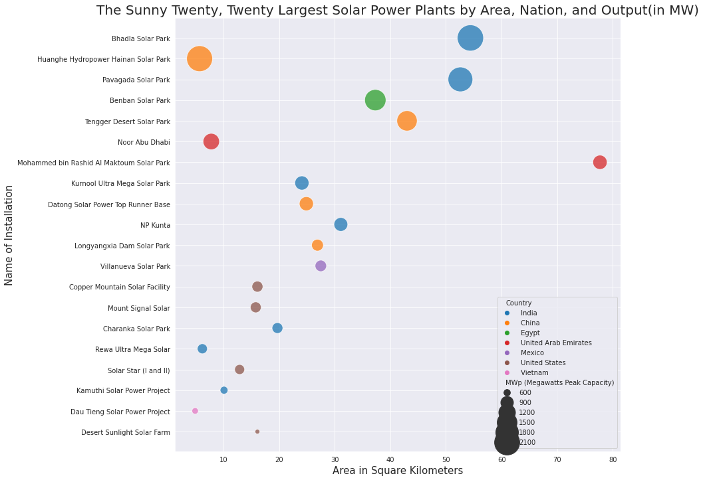
Increasing Demand for Renewable Energy

Slide 3




The Four Star Grid

Slide 4
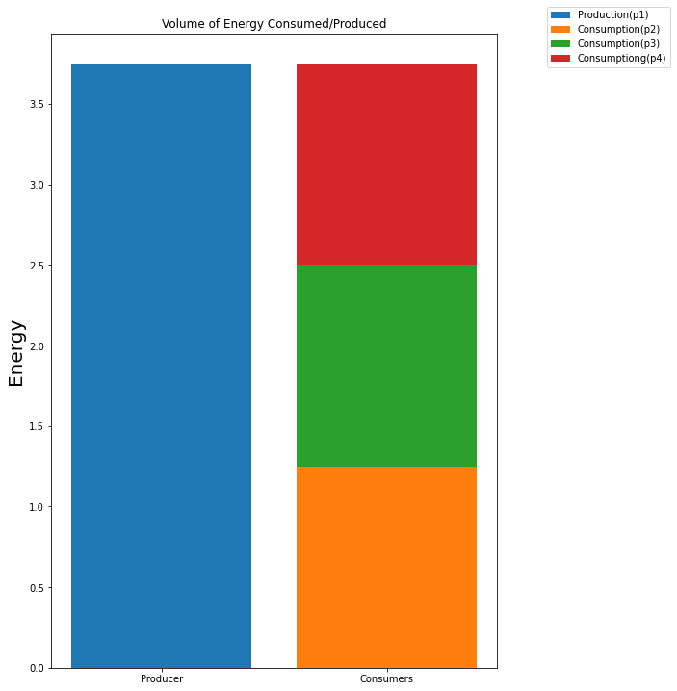
Distribution of Energy

Slide 5
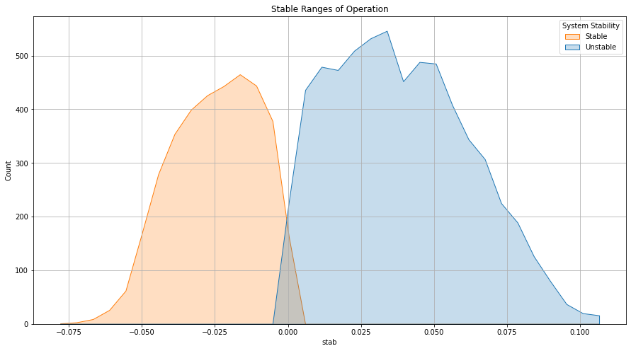
Optimal Ranges of Stability

Slide 6
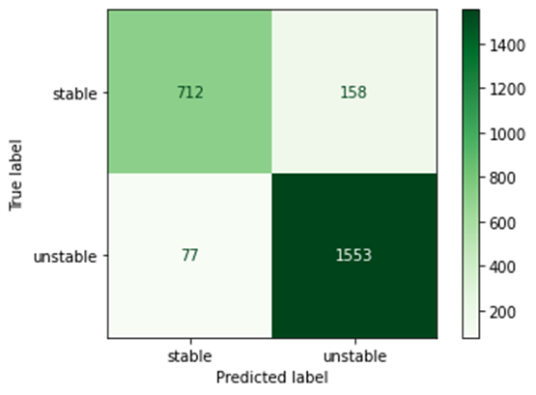
Two Content Layout with Table
 | Precision | Recall | F1-score | Support
Stable | 0.90 | 0.82 | 0.86 | 870
Unstable | 0.91 | 0.95 | 0.93 | 1630
Accuracy |  |  | 0.91 | 2500
Macro Avg | 0.91 | 0.89 | 0.89 | 2500
Weight Avg | 0.91 | 0.91 | 0.90 | 2500
91% accuracy
Only 77 False positives

Slide 7
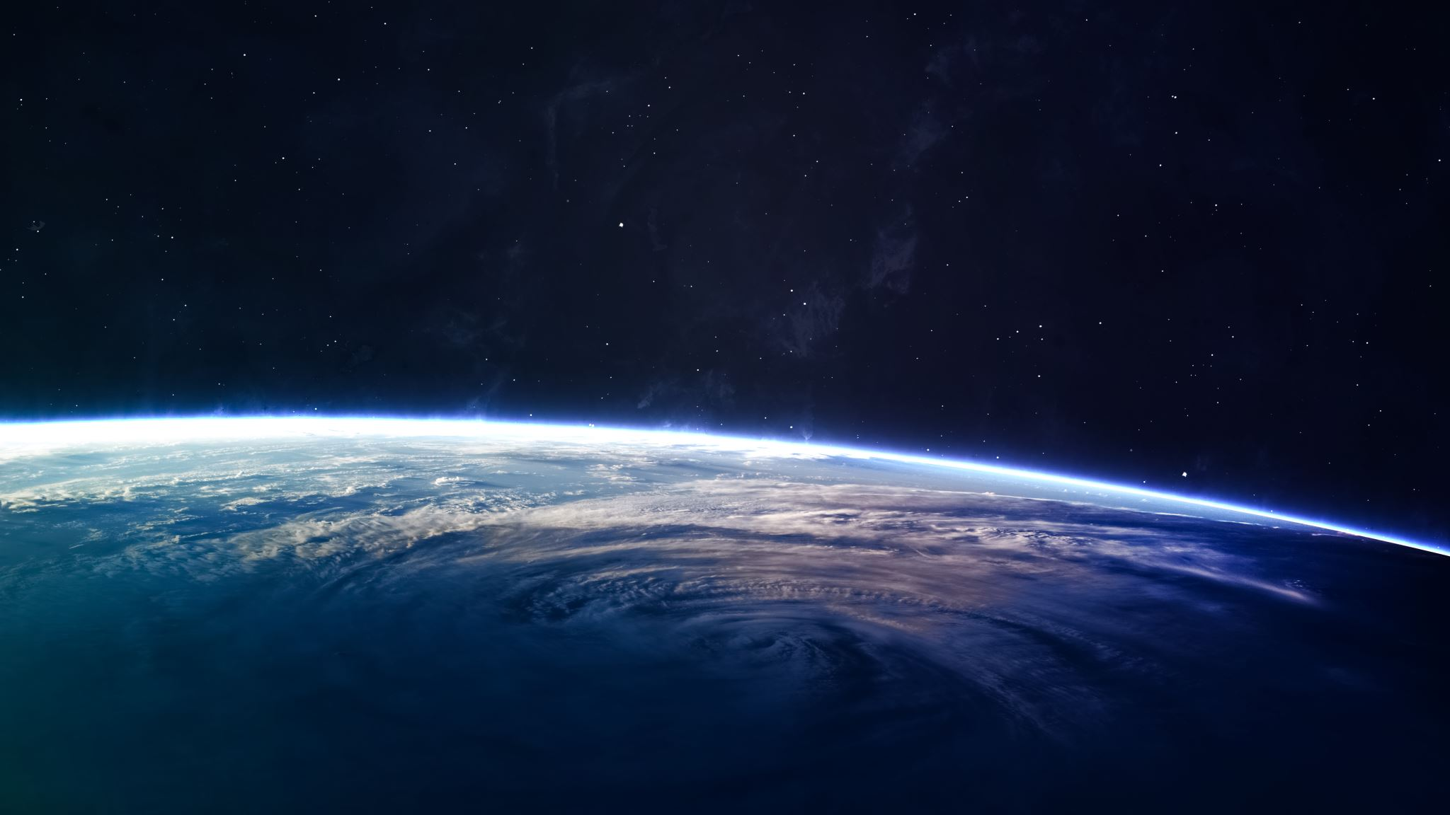
The Planet and I Thank You!

